Slide 1
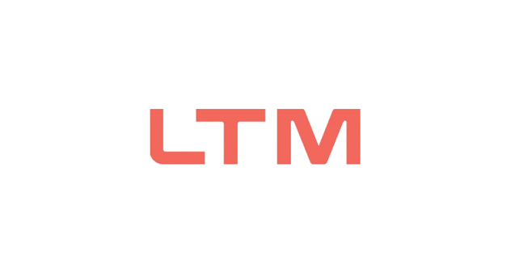

M.Tech Program
Advanced Industry Integrated Programs
Jointly offered by University and LTIMindTree
Project Title
RAG for Secure Enterprise Document Intelligence Using Role-Based Access Control (RBAC)
Team Member
VINOTH KANNA S
CRESCENT 2025-27
Knowledge partner | Implementation partner

Slide 2

RAG for Secure Enterprise Document Intelligence Using Role-Based Access Control (RBAC)
Introduction
Enterprise documents vary widely in sensitivity across departments.
RAG grounds LLM answers in real documents, reducing hallucination.
Most RAG systems ignore who is asking — a security gap.
This project enforces RBAC inside the retrieval pipeline itself.

Slide 3
RAG for Secure Enterprise Document Intelligence Using Role-Based Access Control (RBAC)
Objective
Enforce RBAC at the retrieval layer, not just the UI.
Block unauthorized chunks from ever reaching the LLM.
Give admins tools to manage users and audit logins.
Deliver a working full-stack demo with real authentication.

Slide 4
RAG for Secure Enterprise Document Intelligence Using Role-Based Access Control (RBAC)
Modules Name
Secure Enterprise Document Intelligence
A Retrieval-Augmented Generation System with Role-Based Access Control
Core modules: Data Ingestion & Chunking, Vector Database & Embedding Storage, RBAC Policy Engine, Secure Authentication, RBAC-Filtered Retrieval, RAG Answer Generation, Admin & Audit Module, Document Upload Module, Web Frontend (Node.js).

Slide 5
RAG for Secure Enterprise Document Intelligence Using Role-Based Access Control (RBAC)
Problem Statement
Enterprise documents contain different sensitivity levels.
Conventional RAG may treat documents as equally accessible.
This can expose confidential HR, Finance, or Legal data.
UI-only access control is not sufficient for secure retrieval.
Unauthorized content may reach the LLM before filtering.
Need role-based filtering before retrieval and generation.

Slide 6
RAG for Secure Enterprise Document Intelligence Using Role-Based Access Control (RBAC)
Methodology
RAG Implementation: Retrieve relevant and access-approved document chunks before generating responses.
Two-Layer RBAC: Apply role-based access control during retrieval using database-level metadata filtering followed by an independent application-level access check.
Incremental Development: Develop and test modules independently in the sequence: Ingestion → RBAC-filtered Retrieval → Answer Generation → Authentication → Admin Controls → UI Upload.
Role-Based Validation: Execute the same query using different user roles and verify that retrieved content changes according to their access permissions.
Secure-by-Design: Implement salted password hashing, and audit logging for every login and user query.

Slide 7
RAG for Secure Enterprise Document Intelligence Using Role-Based Access Control (RBAC)
Confidentiality Levels
Level 0 — Public
Level 1 — Internal
Level 2 — Confidential
Level 3 — Restricted
Role | Allowed Departments | Max Level
intern | General | 0 (Public)
employee | General, Engineering, Sales | 1 (Internal)
engineering_manager | General, Engineering | 2 (Confidential)
hr_manager | General, HR | 2 (Confidential)
finance_manager | General, Finance | 2 (Confidential)
legal_counsel | General, Legal, HR, Finance | 3 (Restricted)
executive | All departments | 3 (Restricted)
admin | All departments | 3 (Restricted)

Slide 8
RAG for Secure Enterprise Document Intelligence Using Role-Based Access Control (RBAC)
Approach / Algorithms / Tools
Tools
Backend: Python, FastAPI (REST API layer).
Frontend: Node.js
Document processing: custom chunking (character-based, overlapping windows); text extraction for .txt, .md, .csv, .json, .docx, and .pdf uploads.

Slide 9
RAG for Secure Enterprise Document Intelligence Using Role-Based Access Control (RBAC)
Findings and Results
Secure Document Upload: Uploaded documents became searchable after indexing while maintaining department and confidentiality restrictions.
Admin Controls: User creation, removal, enable/disable functions, and CSV audit-log export were successfully validated.
Grounded Responses: Groq API generated source-cited answers, with extractive-answer fallback when an API key was unavailable.
RBAC Validation: Identical queries from different roles returned different or no results based on permitted departments and confidentiality levels.
Two-Layer Security: Database filtering and application-level re-checks successfully blocked unauthorized chunks, including role-boundary edge cases.
Password Security: Plaintext passwords were never stored, and disabled accounts were rejected even with valid credentials.

Slide 10
RAG for Secure Enterprise Document Intelligence Using Role-Based Access Control (RBAC)
Acknowledgement
I sincerely thank LTM and L&T EduTech for providing the infrastructure, laptop, training room, ID card, and a valuable 2-month opportunity to enhance my technical skills through practical project development. I express my special gratitude to Dr. Ganesh for his continuous guidance, valuable suggestions, and support in improving my project. I also thank the Classroom Managers for their daily monitoring, coordination, and assistance in resolving issues. Finally, my special thanks to Mr. Jayakanthan, Manager – Delivery Operations, L&T EduTech, for his encouragement, support, and for providing this valuable opportunity.

Slide 11
RAG for Secure Enterprise Document Intelligence Using Role-Based Access Control (RBAC)
Conclusion
SentinelRAG demonstrates that Role-Based Access Control can be embedded directly into a RAG retrieval pipeline, closing a gap left by conventional RAG implementations that assume uniform access to a shared corpus.
The defense-in-depth design — enforcing access rules at both the database and application layers — provides resilience against misconfiguration at any single layer.
The system was built and validated as a complete, working full-stack application, covering authentication, retrieval, generation, administration, and document management.
This approach is directly applicable to real enterprise deployments where sensitive, department-specific knowledge must be made searchable without compromising confidentiality.
Future work includes integrating a real identity provider (e.g., Okta or Azure AD), supporting multi-tenant deployments, and extending audit logging into a dedicated compliance datastore.

Slide 12
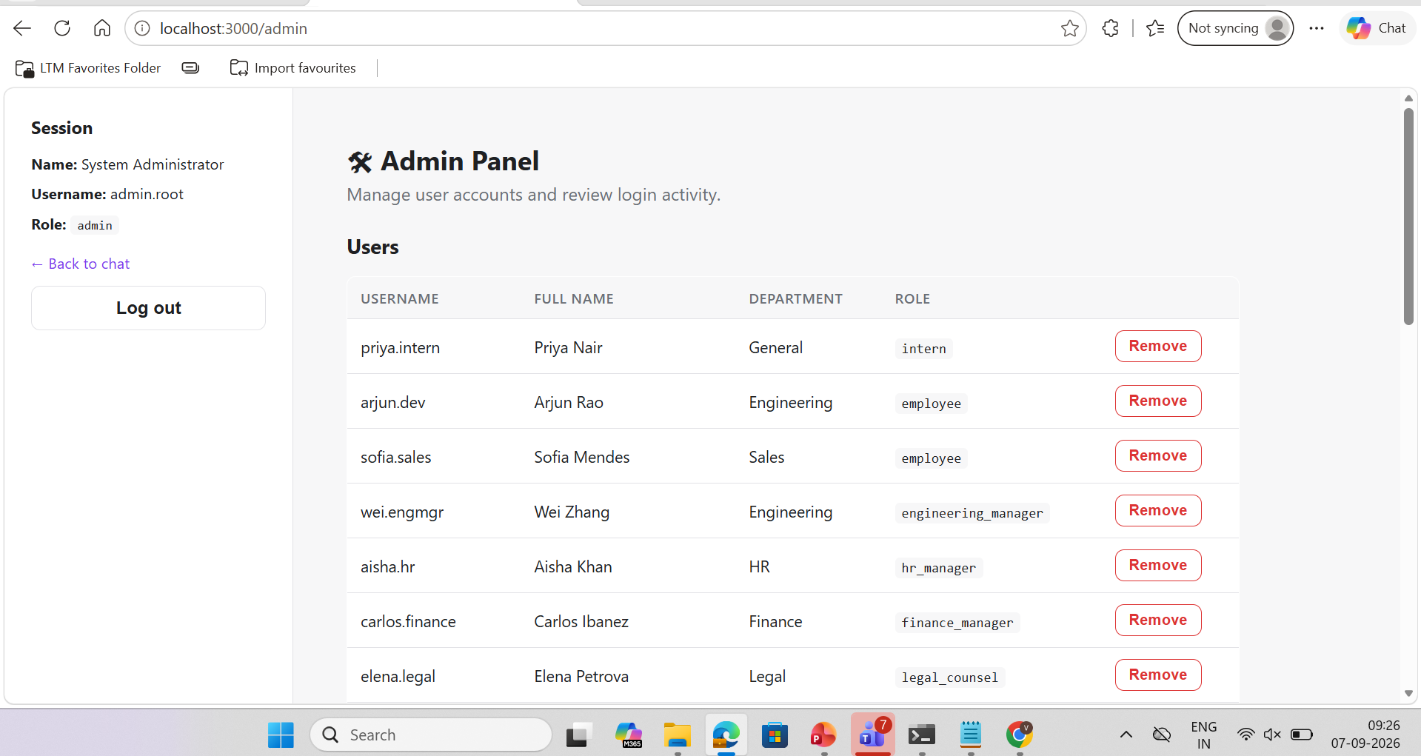
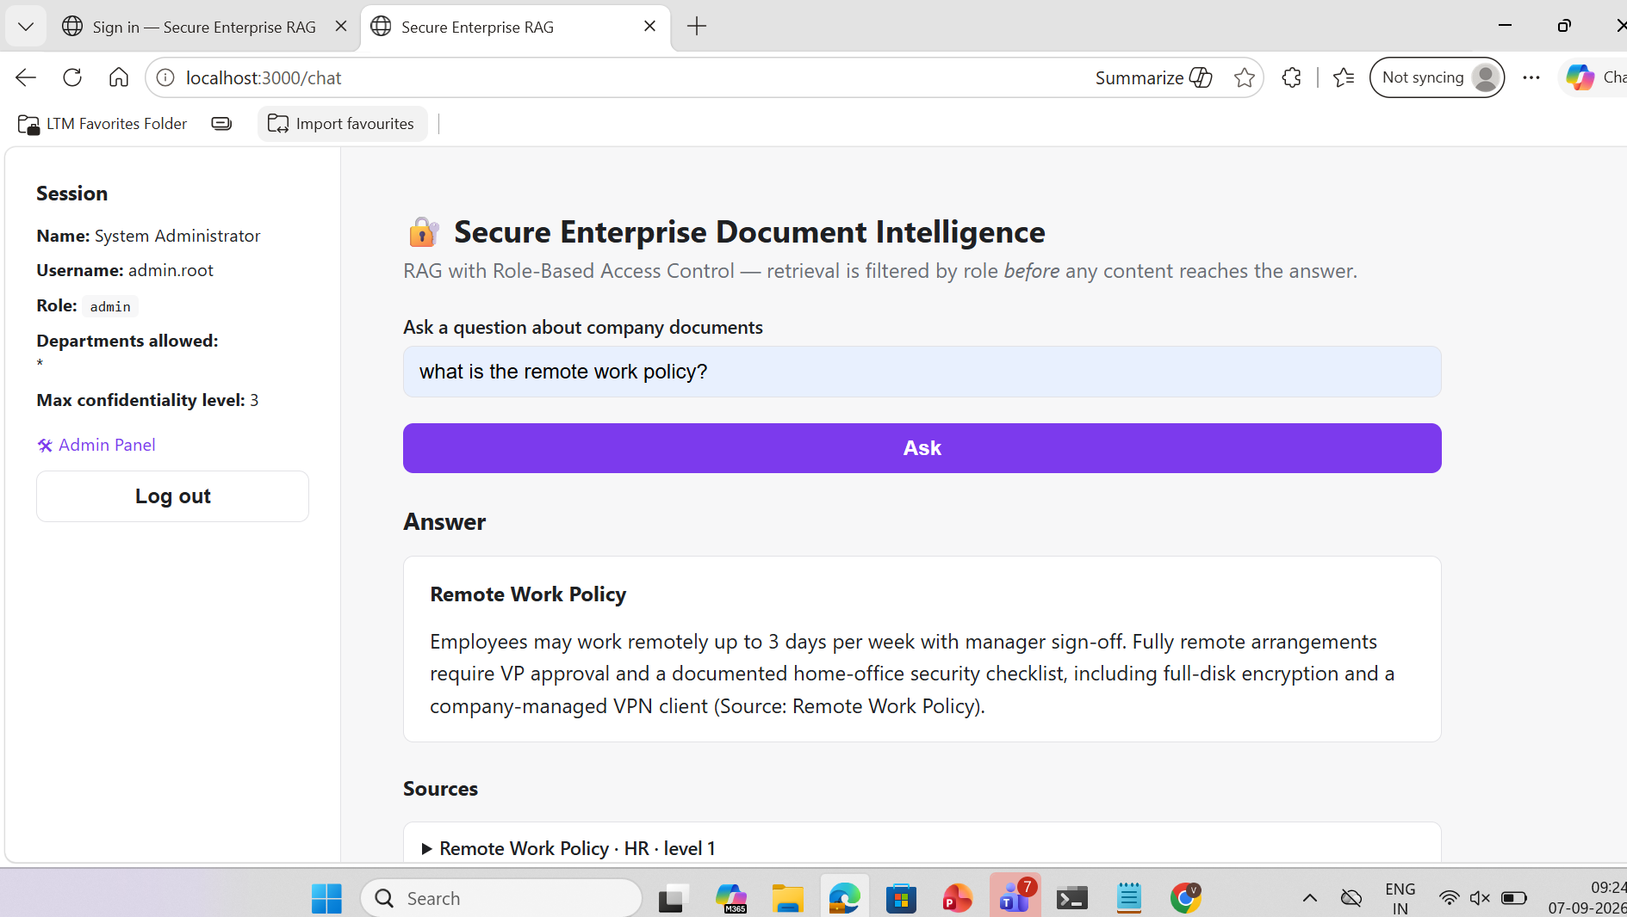
RAG for Secure Enterprise Document Intelligence Using Role-Based Access Control (RBAC)
Result:

Slide 13
RAG for Secure Enterprise Document Intelligence Using Role-Based Access Control (RBAC)
Reference
Lewis, P., et al. (2020). Retrieval-Augmented Generation for Knowledge-Intensive NLP Tasks. Advances in Neural Information Processing Systems (NeurIPS).
Reimers, N., & Gurevych, I. (2019). Sentence-BERT: Sentence Embeddings using Siamese BERT-Networks. Proceedings of EMNLP-IJCNLP.
Sandhu, R. S., Coyne, E. J., Feinstein, H. L., & Youman, C. E. (1996). Role-Based Access Control Models. IEEE Computer, 29(2), 38–47.
FastAPI Documentation. https://fastapi.tiangolo.com
ChromaDB Documentation. https://docs.trychroma.com
Groq API Documentation. https://console.groq.com/docs
NIST Special Publication 800-63B. Digital Identity Guidelines: Authentication and Lifecycle Management.
OWASP Password Storage Cheat Sheet. https://cheatsheetseries.owasp.org/cheatsheets/Password_Storage_Cheat_Sheet.html

Slide 14
M.Tech Program
Advanced Industry Integrated Programs
Jointly offered by University and LTIMindTree
Project Title
Agentic AI Multi-Agent Architecture for Automated Fake News Verification & Explainable Trust Assessment
Team Member
VINOTH KANNA S
CRESCENT 2025-27
Knowledge partner | Implementation partner

Slide 15
Agentic AI Multi-Agent Architecture for Automated Fake News Verification
Introduction
Fake news spreads rapidly through social media and digital platforms.
Traditional fact-checking is slow and difficult to scale.
Existing AI models often give results without clear reasoning.
This project uses Agentic AI to verify claims, collect evidence, and provide an explainable trust score.

Slide 16
Agentic AI Multi-Agent Architecture for Automated Fake News Verification
Objective
Build a Multi-Agent System – Use Claim Extraction Agent, Evidence Retrieval Agent, Source Credibility Agent, Cross-Reference Agent, and Verdict Agent for automated fact-checking.
Verify Claims – Analyze evidence and source credibility through cross-checking.
Generate Trust Scores – Provide explainable trust scores with confidence levels.
Reduce Bias & Ensure Auditability – Use self-checking and maintain an evidence trail.

Slide 17
Agentic AI Multi-Agent Architecture for Automated Fake News Verification
Modules Name
Fake News Verifier Agent — an AI-based Multi-Agent Fact-Checking System
Core modules:
Input & Ingestion Module
Search & Source Discovery Module
Web Scraping & Content Extraction Module
Trust Scoring Module
AI Summarization Module (LLM-based)
Report Generation & User Interface Module

Slide 18
Agentic AI Multi-Agent Architecture for Automated Fake News Verification
Problem Statement
Fake and misleading news spreads rapidly across digital platforms, influencing public opinion before it can be verified.
Existing fact-checking is largely manual, centralized (a few fact-checking organizations), and cannot keep pace with the volume of daily claims.
Users have no quick, trustworthy way to check a claim themselves before sharing it, especially when the claim arrives as a link, a forwarded message, or a voice note.
There is a need for an automated, source-backed, explainable system that can verify a claim in near real-time and show why it reached its conclusion — not just a black-box "true/false" label.

Slide 19
Agentic AI Multi-Agent Architecture for Automated Fake News Verification
Methodology
Input collection — The user submits a claim as text, a URL, or a recorded voice clip (transcribed to text via speech-to-text).
Query formulation — The claim is parsed into a search-friendly query.
Multi-source search — The system queries several independent sources in parallel (news search APIs, a general web search engine, and an encyclopedic source) to gather candidate URLs related to the claim.
De-duplication & ranking — Candidate URLs are merged, duplicates removed, and the most relevant ones selected for deeper analysis (more than 10 sources considered per query).
Content scraping — The top candidate articles are fetched and their main text extracted (ignoring ads, navigation, boilerplate).
Evidence-based scoring — A trust-scoring agent compares the claim against the scraped excerpts and computes a numeric trust score.
AI summarization — A large language model (LLM) reads the excerpts and the claim, and produces a plain-English explanation of whether the evidence supports, contradicts, or is inconclusive about the claim.
Result presentation — The verdict, trust score, AI summary, and the list of cited sources are displayed to the user, with an option to download a PDF report.

Slide 20
Agentic AI Multi-Agent Architecture for Automated Fake News Verification
Approach, Algorithms & Tools
Search
→
Scrape
→
Score
→
Summarize
Backend
Search & Data Sources
Scraping & NLP
Python, FastAPI (REST API framework)
JWT-based authentication, guest mode, rate limiting
PostgreSQL (persistent storage for user history)
SerpAPI / NewsAPI (news search)
Google News RSS (free, no-API-key feed)
DuckDuckGo HTML search (general web)
Wikipedia (background / context)
BeautifulSoup / requests for HTML parsing and article text extraction
Caching layer to avoid redundant re-scraping of the same URL
AI / ML
Trust Scoring
Frontend
Groq-hosted LLM for claim-vs-evidence reasoning and summarization
HuggingFace models for image-related verification
AssemblyAI for speech-to-text (voice claims)
Custom scoring agent weighing source agreement, source count, and excerpt relevance
Combined into a 0–100 trust score mapped to a five-level verdict scale
React + Vite
Custom CSS UI (amber/teal theme)
Live “agent pipeline” status indicator
Client-side PDF report generation (jsPDF)
Groq (Llama 3.3 70B)
Narrative summarization

Slide 21
Agentic AI Multi-Agent Architecture for Automated Fake News Verification
Findings and Results
The system successfully retrieves and cross-references more than 10 independent sources per claim, rather than relying on a single article.
Switching from a single generic search API to a combination of dedicated news search, general web search, and encyclopedic sources significantly improved the relevance of retrieved evidence.
The AI summarization step produces human-readable justifications, making the verdict explainable rather than a black box — e.g. clearly stating when evidence is insufficient instead of guessing.
The trust score and verdict reliably reflect the strength and consistency of evidence across sources: claims with multiple corroborating sources scored high (Real/Likely Real); claims with sparse or contradictory sources were correctly flagged as Unverified.
Average end-to-end verification time per claim stayed within a few seconds, demonstrating feasibility for near real-time use.

Slide 22
Agentic AI Multi-Agent Architecture for Automated Fake News Verification
Acknowledgement
I sincerely thank LTM and L&T EduTech for providing the infrastructure, laptop, training room, ID card, and a valuable 2-month opportunity to enhance my technical skills through practical project development. I express my special gratitude to Dr. Ganesh for his continuous guidance, valuable suggestions, and support in improving my project. I also thank the Classroom Managers for their daily monitoring, coordination, and assistance in resolving issues. Finally, my special thanks to Mr. Jayakanthan, Manager – Delivery Operations, L&T EduTech, for his encouragement, support, and for providing this valuable opportunity.

Slide 23
Agentic AI Multi-Agent Architecture for Automated Fake News Verification
Conclusion
The Fake News Verifier Agent demonstrates that a multi-agent architecture combining search, web scraping, trust scoring, and LLM-based reasoning can automate a meaningful part of the fact-checking process.
By grounding every verdict in cited, scraped source excerpts, the system stays explainable and auditable rather than acting as an opaque classifier.
Supporting text, URL, and voice input makes the tool accessible across different real-world use cases, such as checking a forwarded WhatsApp message or a shared article link.
Future work could include multilingual claim verification, image/video claim verification, browser-extension integration for one-click checking, and fine-tuning the trust-scoring model on a labeled fact-checking dataset for higher precision.

Slide 24
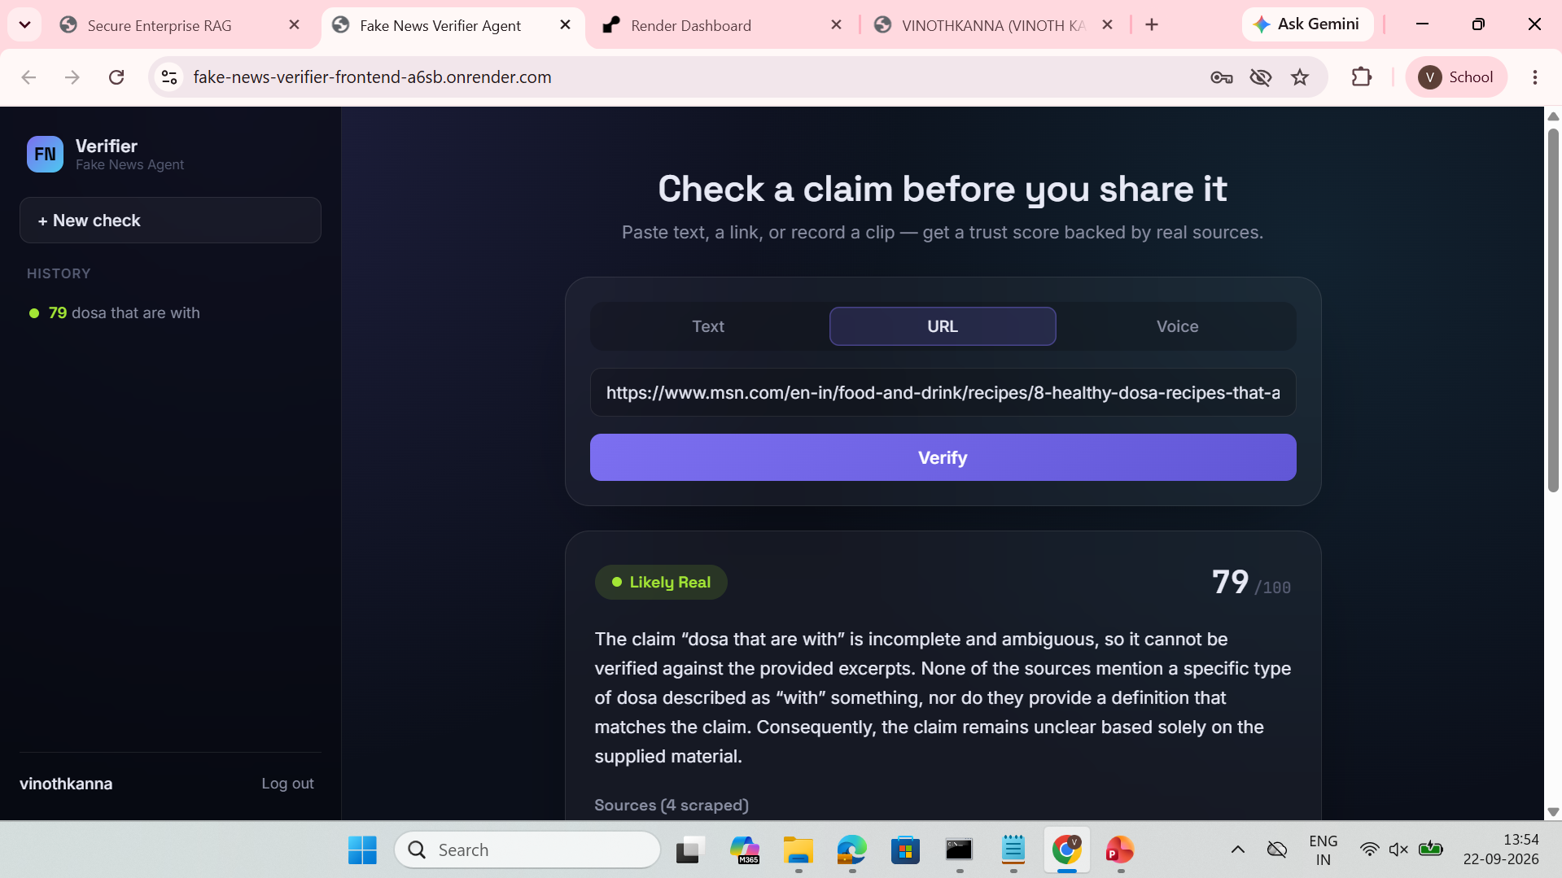
Agentic AI Multi-Agent Architecture for Automated Fake News Verification
Result:
https://fake-news-verifier-frontend-a6sb.onrender.com/

Slide 25
Agentic AI Multi-Agent Architecture for Automated Fake News Verification
Reference
FastAPI Documentation — https://fastapi.tiangolo.com/
React Documentation — https://react.dev/
Groq API Documentation — https://console.groq.com/docs
SerpAPI Documentation — https://serpapi.com/search-api
NewsAPI Documentation — https://newsapi.org/docs
DuckDuckGo HTML Search — https://html.duckduckgo.com/html/
AssemblyAI Speech-to-Text Documentation — https://www.assemblyai.com/docs
HuggingFace Models — https://huggingface.co/models
Shu, K., Sliva, A., Wang, S., Tang, J., & Liu, H. (2017). Fake News Detection on Social Media: A Data Mining Perspective. ACM SIGKDD Explorations.
jsPDF Library — https://github.com/parallax/jsPDF

